Slide 1
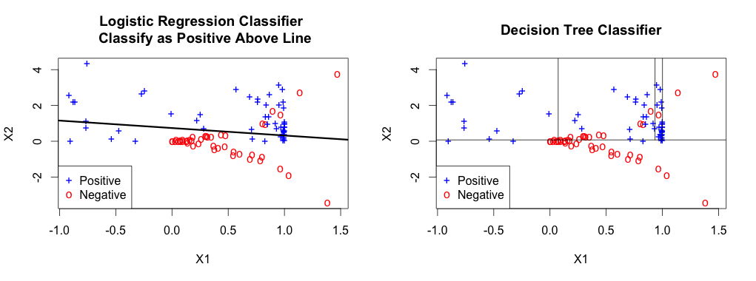
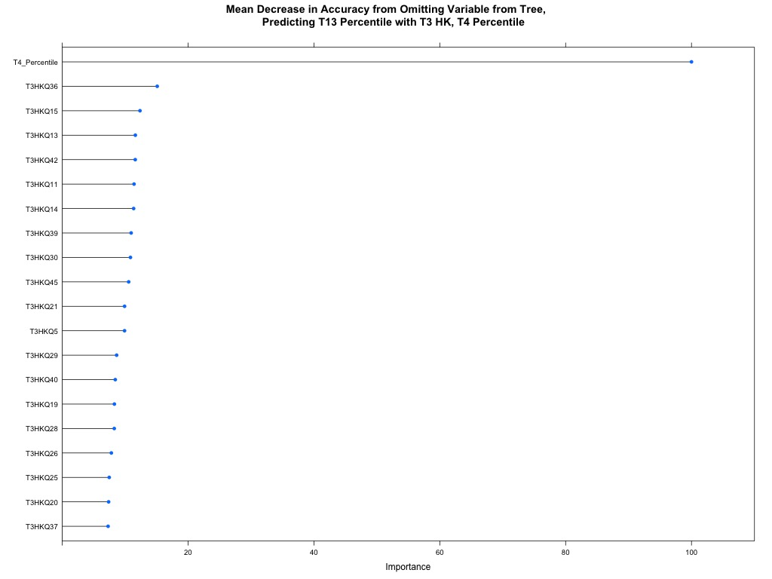
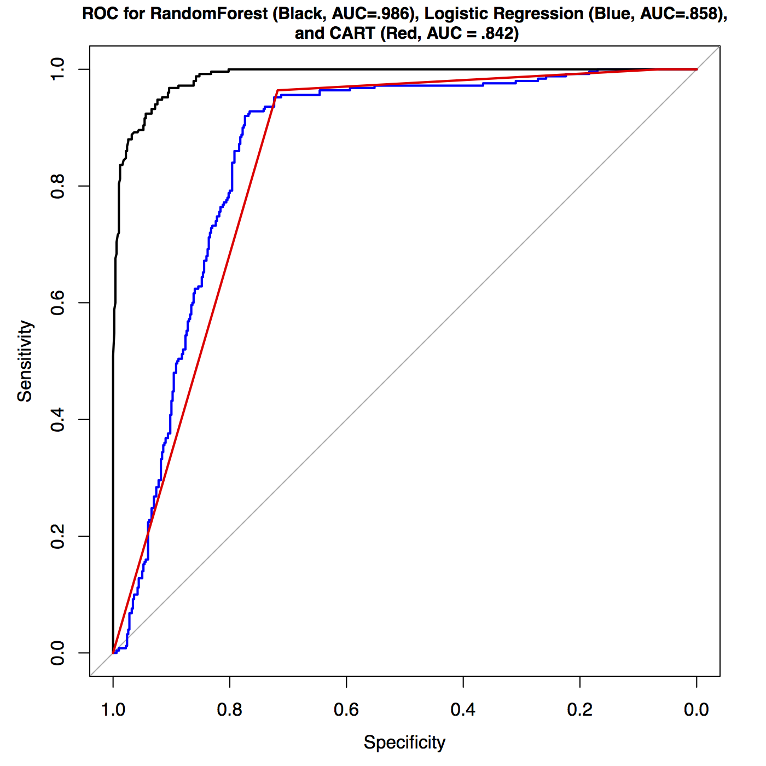
z2iz1i2+1
Using the RandomForest Method to Select Most Valued Items on a Healthy Weight Survey for Young Children
Christopher Aden¹, Christiana Drake¹, Mical Shilts³ and Marilyn S Townsend²
¹Statistics, University of California, Davis, CA, United States;
²Nutrition, University of California, Davis, CA, United States
³Family and Consumer Sciences, California State University, Sacramento, CA, United States.
Abstract
Simulation Example
The RandomForest Algorithm
Selecting Survey Items using RandomForests
The purpose was to compare two statistical methods that identify the most predictive questions for various outcomes including predicting overweight status at a later time point. Head Start and WIC parents and their young children provided data: parent self-administered 43-item Healthy Kids (HK) at 4 time points, nine 24-hour diet + activity recall logs, 3 blood samples and child anthropometrics collected at 3 time points. An importance plot determined the relative importance of each question by computing the average error when the particular question is omitted. Of the 43 behavioral items tested, 16 are selected for the final model. The chosen model has a similar classification rate as a stepwise regression procedure in looking at overweight status; it also selects the most predictive variables and provides a measure of their importance. The advantage of random forest is that it selected models reasonably supported by nutritional knowledge while avoiding problems faced by stepwise regression in fitting large models. Random forest has potential for use in nutritional studies.
We demonstrate the inability for logistic regression to classify as well as CART in problems where a linear logistic model doesn’t work. We simulate data from two populations (circles and crosses) according to the following algorithm:
For i=1,…, n₁ negative samples (circles):
Sample z_{1i}, z_{2i} independently from a standard normal, N(0,1), distribution
Return covariates x_{1i} = cos(z_{1i}²), and x_{2i} = |z_{2i}|*sqrt(z_{1i}²+1)
For j=1, …, n₂ positive samples (crosses):
Sample z_{1j}, z_{2j} independently from a standard normal, N(0,1), distribution
Return covariates x_{1j} = |z_{2j}*sin(z_{1j})| and x_{2j} = z_{1j}* z_{2j}²
A highly non-linear pattern is observed when plotting the two variables against each other with different points for the group. Logistic regression has trouble discriminating between the two groups because they overlap in a highly irregular way. With hypothesis testing, logistic regression would find significant relationships between both variables. This illustrates how it is possible to have a highly significant model that is unable to predict well. As such, we cannot rely on hypothesis testing to show whether a model will be predictive.
RandomForests (RF) is a statistical method based on trees described above. For each iteration up to some desired number, RF takes a subset of the samples, and a subset of the predictors, and finds the optimal tree for this subset. It then uses that tree to predict the samples it did not train on, and computes the prediction error. This process repeats at each iteration. The weight each tree contributes to deciding the final outcome is determined by how well the tree predicted observations that were similar. RF is different from decision trees in that it is an ensemble method, combining information from many trees. This gives the forest robustness, as any over-fitting from any one single tree is averaged out. This means RF often has much higher accuracy than CART or logistic regression. However, because RF is based on an average of many trees, it cannot easily be interpreted or graphed—it is simply a tool for generating predictions and determining predictors.
The most alluring feature of RF, is the ability to fit models where there are a large number of predictors relative to sample size. Logistic regression will either not work or work poorly. RF averts this problem by fitting only a subset of the predictors at a time. RF gives us a novel method for determining which predictors are the most important for the outcome of interest. The variable importance plot works by computing the out-of-sample error for all trees, then omitting a particular predictor from that tree. The difference of these errors is then divided by the standard deviation of the differences over all trees. If a predictor has great predictive power, omitting it from a tree will greatly reduce the accuracy of the tree. Averaging results for all trees ensures that the predictor is not an artifact of one tree over-fitting a subset of data.
On our simulation task from before, RF completely dominates both logistic regression and trees. Below are the receiver operating characteristic (ROC) curves and the misclassification rates (in percent) for the three classifiers.
The Healthy Kids (HK) project looked at identifying the factors that make up healthy eating and activity habits in both parents and children. Head Start and WIC parents and their young children provided data: parent self-administered 43-item Healthy Kids (HK) at four time points, nine 24-hour diet and activity recall logs, three blood samples and child anthropometrics collected at three time points.
Statistical modeling was employed to see if we could identify which children early-on would be overweight 24 months in the future, on the basis of current BMI percentile and the responses from their early questionnaires at baseline. The purpose was to see if we could predict from current BMI, eating habits, sleep, screen time, and physical activity whether a child would be overweight in the future.
Child-parent pairs (N=90) provided surveys and BMI measurements at the first survey administration (T3), first BMI measurement (T4) and the later BMI and survey administration (T13). Logistic regression was highly unstable trying to fit all survey questions (p=44+1 BMI Percentile), so forward stepwise regression was performed to reduce the number of predictors. Alternatively, we fit RandomForests on the same data set and used the variable importance plot to identify the most predictive questions.
Introduction
Classification is a common goal in nutrition, whether it be classifying a subject into normal or overweight groups, or predicting whether a child will become obese in the future. Common methods in the literature are logistic regression, discriminant analysis, and decision trees.
Logistic regression models look at the probability of being in a particular group using a linear combination of the predictors on the logit scale. Unlike more modern techniques, logistic regression allows one linear relationship of predictors, requiring that a single, global line be specified. The coefficients in a logistic regression model may be interpreted as the effect of the predictor on the log-odds ratio. For example, if we were modeling the probability that a child is overweight as a function of past BMI percentile, a coefficient of .05 would mean that for each 15-point increase in percentile, the odds of being overweight later in time would approximately double.
Classification and regression trees (CART) are a more flexible tool that partitions the data into two categories, one predictor at a time, until the variability within a partition is homogenous, relative to the other partitions. This process continues until we can no longer find a predictor that greatly reduces the heterogeneity. Like logistic regression, having more nodes decreases the in-sample misclassification, but also increases the complexity, making it harder to interpret. Both methods are also subject to “over-fitting” (observing a large out-of-sample error when the in-sample error is small). CART lacks the overall interpretation of logistic regression (coefficients as log-odds ratios), but computing predicted categories is straightforward and analogous to reading a flow chart.
The advantage of CART is that it allows for complicated interactions between predictors that would not be possible without adding many additional terms to a logistic regression. This makes it ideal in situations where the exact relationship of the predictors is unknown or difficult to specify.
Figure 1: A comparison of logistic regression versus trees.
Table 1: The hypothesis test for the logistic regression.
Figure 3: A Variable Importance Plot for the top 20 predictors with RF
Table 3: Classification rates for the full logistic model, stepwise logistic model, and RandomForests
 | Estimate | SE | z-value | p-value
(Intercept) | -0.631 | 0.103 | -6.155 | <0.00001
X1 | 0.357 | 0.138 | 2.592 | 0.0096
X2 | 0.854 | 0.080 | 10.615 | <0.00001
Full Logistic | Actually Positive | Actually Negative
Predicted Positive | 46.2 | 16.5
Predicted Negative | 21.6 | 15.6
CART are not without problems, however. They are very prone to over-fitting, that is, they tend to perform better on data used for estimating where to make splits in a classification problem. This hurts their predictive power, which is a task we want to carry out on data outside our sample. A more robust procedure would be to hold out some data each time and build a tree on the data that was not withheld, training afterwards on the hold-out. This leads us into the RandomForest.
Stepwise Logistic | Actually Positive | Actually Negative
Predicted Positive | 59.5 | 7.7
Predicted Negative | 8.2 | 24.7
Figure 2: A comparison of logistic regression versus trees.
Table 2: The hypothesis test for the logistic regression.
RandomForests | Actually Positive | Actually Negative
Predicted Positive | 64 | 10.6
Predicted Negative | 3.9 | 21.6
Logistic | Actually Positive | Actually Negative
Predicted Positive | 41.0 | 13.6
Predicted Negative | 8.8 | 36.5
Conclusions
The same framework used in classification problems can be used in regression problems with very minimal modification. Instead of needing to perform linear regression for continuous responses, and logistic regression in classification problems, RF can be used in a number of contexts, including continuous regression, classification, and survival analysis.
CART | Actually Positive | Actually Negative
Predicted Positive | 40.6 | 5.3
Predicted Negative | 9.4 | 44.7
Acknowledgements
RandomForests | Actually Positive | Actually Negative
Predicted Positive | 46.3 | 3.8
Predicted Negative | 3.7 | 46.2
Supported by National Research Initiative #2009-55215-05019 & Agriculture and Food Research Initiative #2010-85215-20658 from USDA National Institute of Food and Agriculture, Human Nutrition & Obesity 93330.

